Slide 1
Wintershall Assemblies Classroom Reflection

Slide 2
Reflection Judas agrees to betray Jesus
Matthew 26: 14-16

Slide 3
Bible Explore Judas agrees to betray Jesus
Matthew 26:14-16
https://www.biblegateway.com/passage/?search=%09Matthew+26%3A14-16&version=NIV
Commentary

Slide 4
Actor insights
Why do I take part in the Wintershall productions?
How does dramatising events from the Gospels impact my life?
What have I learnt about Jesus and his impact on people from playing this part?

Slide 5
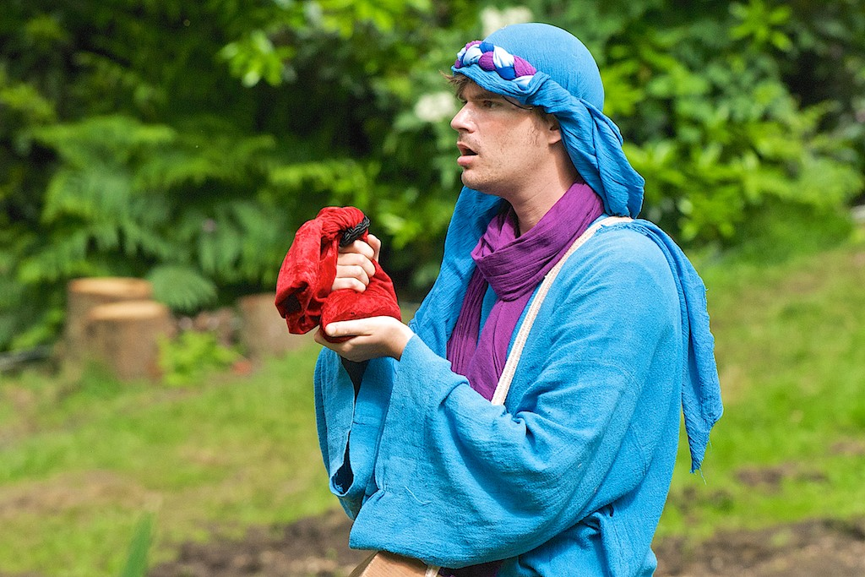
Reflecting on ‘Judas agrees to betray Jesus’. I wonder…
Close your eyes and be still and quiet.
Think back over the drama.
I wonder what you saw?
I wonder what you heard?
I wonder what emotions you felt?
I wonder what you remembered?
I wonder what challenged you?
I wonder what you learnt about Jesus?

Slide 6
Props as signs and symbols
How did the actor use the props to help them tell the story?
What else could these props symbolise in relation to the story?
What other props might you use to help you retell this story?

Slide 7
Wintershall Assembly prayer
Lord Jesus,
teacher from Nazareth,
the way, the truth and the life
help us to walk in your footsteps of humility, love and kindness,
to discover truth from your teaching
and to live a life that brings joy to others
Amen

Slide 8
Book your school visit to ‘The Life of Christ’
a Wintershall production
https://www.wintershall-estate.com/events/the-life-of-christ/
Enriching understanding of Christianity
Supporting RE teaching and learning

Slide 9
www.wintershall-education.com

